Slide 1
Chapter 8 Mutually Independent Paths and Mutually Independent cycles

Slide 2
The Professional Tour Company makes a promotional plan for summer vacation, illustrated by Figure 8.1. The tour begins at the vertex marked “Begin” and ends with the vertex marked “End”. Along the tour, the visitors will visit all the cities and stay at each city exactly one day. The size of the hotel means that each tour must be limited to a maximum of 100 people.
Figure 8-1

Slide 3
The promotion plan is very successful and 200 people sign up for the tour. At first, the travel agency decides to serve only the first 100 customers. But the manager of the tour company proposes splitting the group into two groups of 100 and having the two groups travel simultaneously. If timed right, the groups should not overlap except for at the beginning and end of the tours (Figure 8-2).
Figure 8-2

Slide 4
For how the travel plan works, see Figure 8-3.
Figure 8-3

Slide 5
With a successful experience under their belts, the company proposes a new travel itinerary, shown in Figure 8-4.
Figure 8-4

Slide 6
Again, the manager is tasked with coordinating two simultaneous tour groups. One solution is shown in Figure 8-5.
Figure 8-5

Slide 7
Yet there are many other possible combinations for accommodating two groups simultaneously:
Figure 8-6
Note that the tours work with any two different beginning and ending vertices.

Slide 8
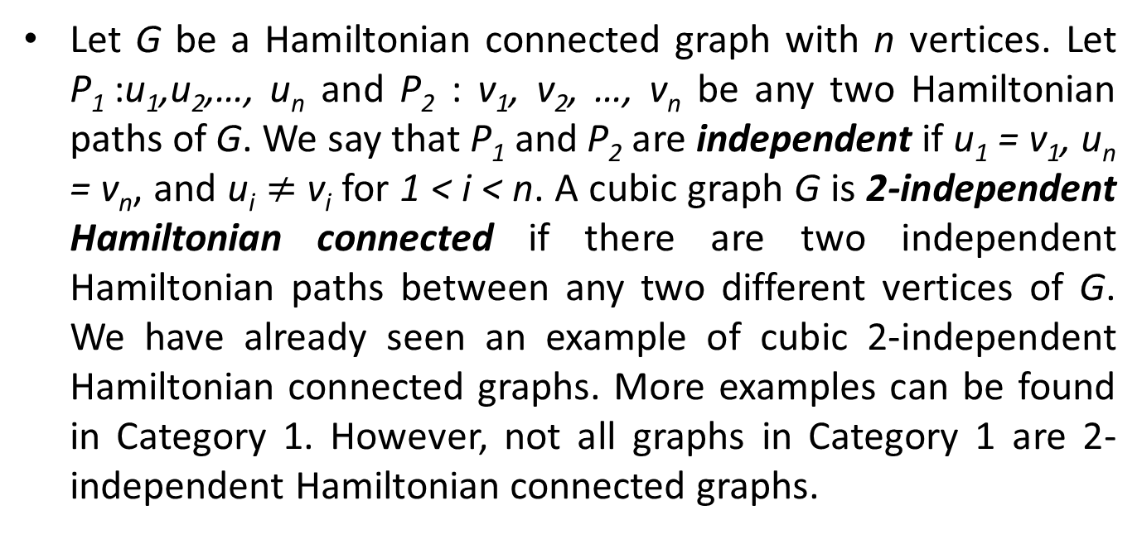
Let G be a Hamiltonian connected graph with n vertices. Let P₁ :u₁,u₂,…, u_{n} and P₂ : v₁, v₂, …, v_{n} be any two Hamiltonian paths of G. We say that P₁ and P₂ are independent if u₁ = v₁, u_{n} = v_{n}, and u_{i} $≠$ v_{i} for 1 < i < n. A cubic graph G is 2-independent Hamiltonian connected if there are two independent Hamiltonian paths between any two different vertices of G. We have already seen an example of cubic 2-independent Hamiltonian connected graphs. More examples can be found in Category 1. However, not all graphs in Category 1 are 2-independent Hamiltonian connected graphs.

Slide 9
It is interesting to note that all cubic 2-independent Hamiltonian connected graphs are 1-fault tolerant Hamiltonian. Again, we can show this fact with Figure 8-7.
Figure 8-7

Slide 10
The graph in Figure 8-7 is a cubic 2-independent Hamiltonian connected graph. Suppose that some edge is faulty. Without loss of generality, let us assume that the edge joining vertices 16 and 20 is faulty, as shown in Figure 8-8.
Figure 8-8

Slide 11
Since the graph is 2-independent Hamiltonian connected, there are 2-independent Hamiltonian paths joining between vertices 16 and 17 as shown in Figure 8-9.
Figure 8-9

Slide 12
Note that vertex 17 is adjacent to vertex 16. One Hamiltonian path, the blue one, uses the edge (16,20) and the other Hamiltonian path, the yellow one, use the edge (16,1). Adding the blue edge (16, 17) to the yellow Hamiltonian path will result in a fault-free Hamiltonian cycle (Figure 8-10).
Figure 8-10

Slide 13
Suppose that some vertex is faulty. Without loss of generality, let us assume that vertex 1 is faulty as shown in Figure 8-11.
Figure 8-11

Slide 14
Since the graph is 2-independent Hamiltonian connected, there are 2-independent Hamiltonian paths joining between vertices 1 and 17, as shown in Figure 8-12.
Figure 8-12

Slide 15
Note that vertex 16 is a common neighbor of vertex 1 and vertex 17. One Hamiltonian path, the dotted blue one, includes the edge (1,16) and excludes the edge (16,17). Conversely, a fault-free Hamiltonian cycle with the faulty vertex 1 can be formed by excluding the edge (1,16) and including the light blue edge (16,17). See Figure 8-13.
Figure 8-13

Slide 16
Now, let us discuss some interesting examples. We have seen that the graph in Figure 8-1 is 2-independent Hamiltonian connected. Thus, it is Hamiltonian connected and 1-fault tolerant Hamiltonian. Note that this graph is globally 3*-connected. By trial and error, we can check that the graph is 2-independent Hamiltonian connected.
The graph in Figure 8-14 is Hamiltonian connected, 1-fault tolerant Hamiltonian, and globally 3*-connected. However, this graph is not 2-independent Hamiltonian connected.

Slide 17
Figure 8-14

Slide 18
To prove this fact, consider the beginning vertex and the ending vertex labeled in Figure 8-14. Note that the two terminal vertices are adjacent. This means the Hamiltonian paths are uniquely determined by the second vertex. Thus, we have two Hamiltonian paths shown in Figure 8-15. Obviously, these two Hamiltonian paths are not independent. Thus, the graph is not 2-independent Hamiltonian connected.
Figure 8-15

Slide 19
Now, consider the graph in Figure 8-16.
Figure 8-16

Slide 20
By trial and error, we can check that this graph is 2-independent Hamiltonian connected. Thus, it is Hamiltonian connected and 1-fault tolerant Hamiltonian. It is easy to observe that this graph can be obtained by a sequence of vertex expansions of the bipartite graph found in Figure 8-17. Since any bipartite graph is not globally 3*-connected, the graph in Figure 8-16 is not globally 3*-connected.
Figure 8-17

Slide 21
Let us consider the graph in Figure 8-18.
Figure 8-18

Slide 22
Note that the graph in Figure 8-18 can be obtained from the graph in Figure 5-24 by a sequence of vertex expansions. The graph in Figure 5-26 can be shown to be 1-fault tolerant Hamiltonian. However, it is neither Hamiltonian connected nor globally 3*-connected. Note that the properties of 1-fault tolerant Hamiltonian and globally 3*-connected property do not change after undergoing vertex expansion. Thus, the graph in Figure 8-18 is 1-fault tolerant Hamiltonian but not globally 3*-connected. We can check whether the graph in Figure 8-18 is Hamiltonian connected. We can claim that z is the second vertex in any Hamiltonian path joining x to y. Thus, there are not two independent Hamiltonian paths joining x to y. Therefore, the graph is not 2-independent Hamiltonian connected if our claim holds.

Slide 23
Suppose that there exists a Hamiltonian path joining x to y such that z is not the second vertex. If so, there exists a Hamiltonian cycle for the graph in Figure 8-19.
Figure 8-19

Slide 24
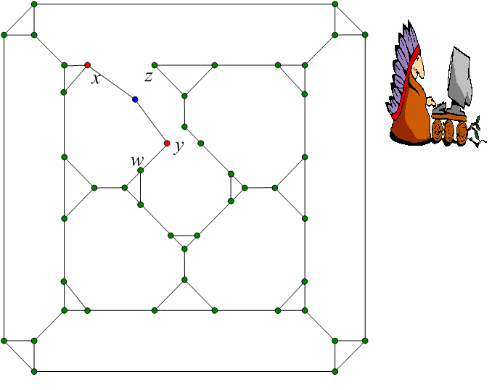
Now, we have two cases depending on whether the vertex (y,w) is part of the Hamiltonian cycle. Suppose that (y,w) is in the Hamiltonian cycle. If so, the graph in Figure 8-20 is Hamiltonian.
Figure 8-20

Slide 25
It is easy to note that the vertices of every cycle of length 3 must be traversed consecutively. Thus, all vertices of cycle of length 3 can be shrunk into a single vertex. Therefore, the graph in Figure 8-21 is Hamiltonian.
Figure 8-21

Slide 26
Note that the graph in Figure 8-21 is a planar graph such that there are 9 subregions in total, with 1 subregions bounded by 4 edges, 7 subregions bounded by 5 edges, and 1 subregion bounded by 11 edges. For any integer i, we define x_{i} =f_{i}-g_{i} where f_{i} denotes the number of subregions inside bounded by i edges and g_{i} denotes the number of subregions outside bounded by i edges. But according to the Grinberg condition, 2x₄+3x₅+9x₁₁=0. 2x₄ is a multiple of 3. However, x₄ is either 1 or -1. Thus, 2x₄ is either 2 or -2. It is not a multiple of 3, leaving us with a contradiction. Thus, the graph in Figure 8-21 is not Hamiltonian. Therefore, the graph in Figure 8-20 is not Hamiltonian.

Slide 27
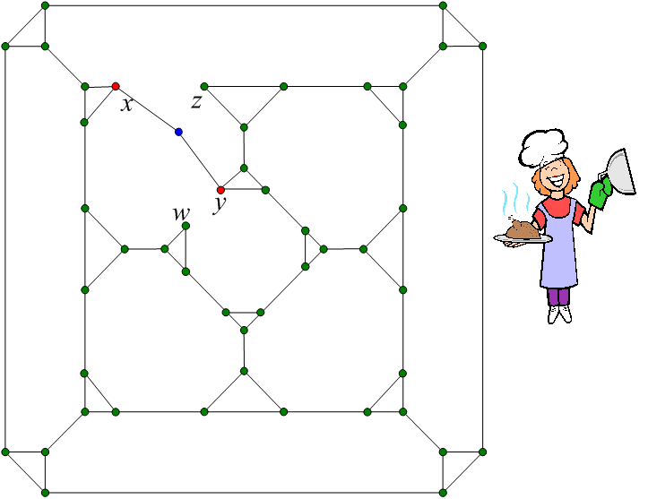
Suppose that (y,w) is not in the Hamiltonian cycle. Then suppose that the graph in Figure 8-22 is Hamiltonian.
Figure 8-22

Slide 28
Again, all vertices of cycle of length 3 can be shrunk into a single vertex. Thus, the graph in Figure 8-23 is Hamiltonian.
Figure 8-23

Slide 29
Note that the graph in Figure 8-23 is a planar graph such that there are 8 subregions in total, with 1 subregion bounded by 4 edges, 6 subregions bounded by 5 edges, and 1 subregion bounded by 8 edges. For any integer i, we define x_{i} =f_{i}-g_{i} where f_{i} denotes the number of subregions inside bounded by i edges and g_{i} denotes the number of subregions outside bounded by i edges. But according to the Grinberg condition, 2x₄+3x₅+6x₁₁=0. 2x₄ is a multiple of 3. However, x₄ is either 1 or -1. Thus, 2x₄ is either 2 or -2. It is not a multiple of 3, leaving us with a contradiction. Thus, the graph in Figure 8-23 is not Hamiltonian. Therefore, the graph in Figure 8-22 is not Hamiltonian.

Slide 30
Therefore, the graph in Figure 8-18 is not 2-independent Hamiltonian.
Figure 8-24 is the map of our town. We live at vertex 1. At Christmas, we decide to visit all the vertices of the graph to go Christmas caroling. However, my family has three choruses: male, female, and children. Thus, we need to sing three songs at each vertex. The problem is the space at each vertex is not enough to host all three chorus at the same time. Moreover, it would take too long to stay at each vertex for three songs. Can you find a way to solve this problem?

Slide 31
Figure 8-24

Slide 32
The following figures show the eventual solution.
The tour for the male chorus is shown in Figure 8-25.

Slide 33
Figure 8-25

Slide 34
The tour for the female chorus is shown in Figure 8-26.

Slide 35
Figure 8-26

Slide 36
The tour for the children’s chorus is shown in Figure 8-25.

Slide 37
Figure 8-27

Slide 38
It is clear from the following chart that this arrangement results in the three groups all being at a different vertex at any time period. There is no overlap except at the beginning and end.
Figure 8-28

Slide 39
Professor Rau also wants to do the same with three choruses he has put together. He live at vertex 22. Can you help solve his problem?

Slide 40
Figure 8-29

Slide 41
The solution is provided below (Figure 8-30).
Figure 8-30

Slide 42
After our previous experience, we decide to do the same thing starting from our church, located at vertex 21. Can you help us solve the problem?

Slide 43
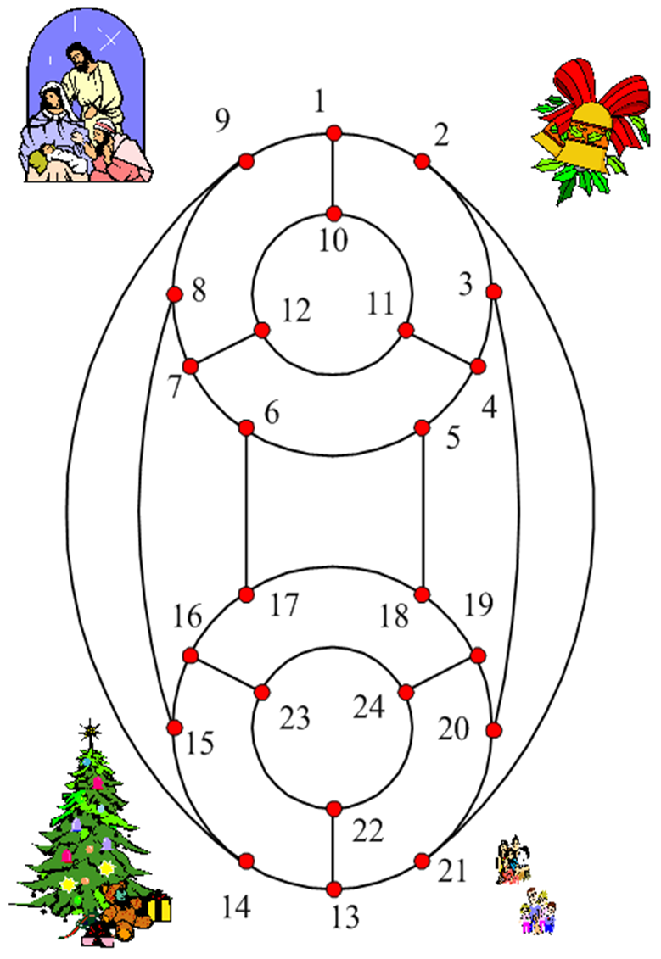

Figure 8-31

Slide 44
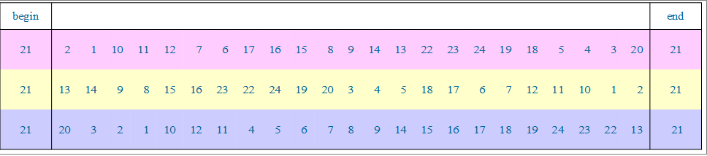
A solution is provided below (Figure 8-32).
Figure 8-32

Slide 45
As you may have guessed, we can always find three Hamiltonian cycles for Figure 8-24, no matter what vertex we start at.

Slide 46
Let G be a Hamiltonian graph with n vertices. A Hamiltonian cycle C of a graph G can be viewed as an ordered set u₁,u₂,…,u_{n},u₁ of vertices such that u_{i} ≠ u_{j} for i ¹≠ j and u_{i} is adjacent to u_{i+1} for every i ∈{1,2,…,n-1} and u_{n} is adjacent to u₁. The vertex u₁ is the starting vertex and u_{i} is the ith vertex of C. Two Hamiltonian cycles C₁:u₁,u₂,…,u_{n},u₁ and C₂: v₁,v₂,…,v_{n},v₁ of G are independent if u₁ = v₁ and u_{i} ≠ v_{i} for every i ∈{2,3,…,n}. A set of Hamiltonian cycles {C₁,C₂,…,C_{k}} of G is mutually independent if its elements are pairwise independent. We have already seen an example of cubic graphs with three mutually independent Hamiltonian cycles starting at any vertex. More examples can be found in Category 1 and Category 2. However, not all graphs in Category 1 and Category 2 have three mutually independent Hamiltonian cycles starting at any vertex.

Slide 47
In this book, we only interested in cubic Hamiltonian graphs. With this condition, the maximum number of mutually independent Hamiltonian paths between an two different vertices is 2. Moreover, the maximum number of mutually independent Hamiltonian cycles that begin with any vertex is 3. Thus, we have the following interesting examples of cubic graphs.

Slide 48
In Figure 8.33, we have an example of cubic graph that there are three mutually independent Hamiltonian cycles that begin with any vertex. Moreover, there are two mutually independent Hamiltonian paths between any two different vertices.

Slide 49
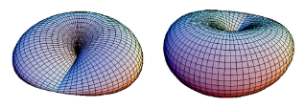
Figure 8.33

Slide 50
In Figure 8.34, we have an example of cubic graph that there are three mutually independent Hamiltonian cycles that begin with any vertex. The graph is Hamiltonian connected. However, we cannot find two mutually independent Hamiltonian paths between some vertices.

Slide 51

Figure 8.34

Slide 52
In Figure 8.35, we have an example of cubic graph that there are three mutually independent Hamiltonian cycles that begin with any vertex. Yet, this graph is not Hamiltonian connected. Thus, there is no Hamiltonian path between some pair of vertices.

Slide 53
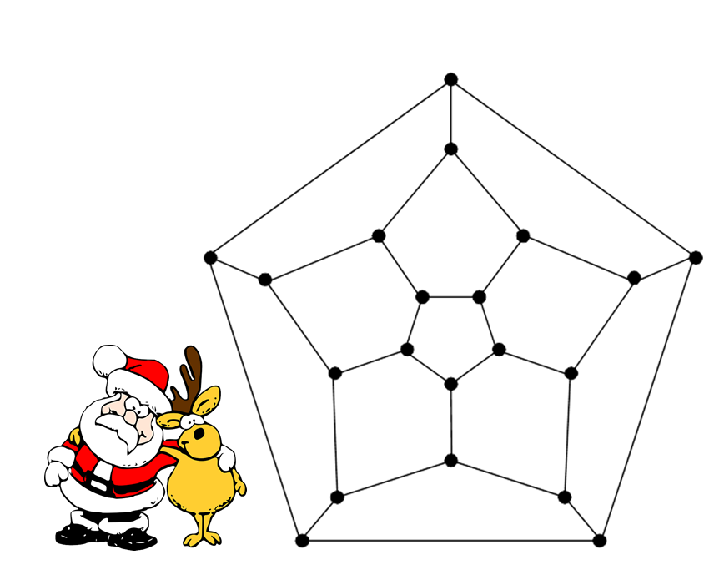
Figure 8.35

Slide 54
In Figure 8.36, we have an example of cubic graph that there are two but not three mutually independent Hamiltonian cycles that begin with any vertex. Moreover, there are two mutually independent Hamiltonian paths between any two different vertices.

Slide 55

Figure 8.36

Slide 56
In Figure 8.37, we have an example of cubic graph that there are two but not three mutually independent Hamiltonian cycles that begin with any vertex. The graph is Hamiltonian connected. However, we cannot find two mutually independent Hamiltonian paths between some vertices.

Slide 57
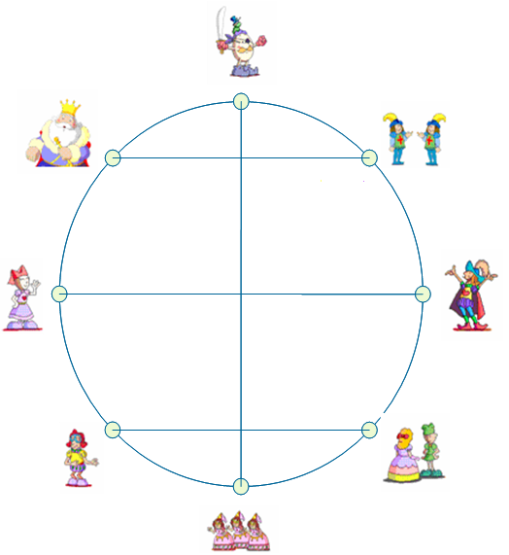
Figure 8.37

Slide 58
In Figure 8.38, we have an example of cubic Hamiltonian graph that there are two but not three mutually independent Hamiltonian cycles that begin with any vertex. However, the graph is not Hamiltonian connected.

Slide 59

Figure 8.38

Slide 60
In Figure 8.39, we have an example of cubic Hamiltonian graph. However, there is no two mutually independent Hamiltonian cycles that begin with some vertex. Moreover, the graph is Hamiltonian connected. Yet, we can not find two mutually independent Hamiltonian paths between some vertices.

Slide 61

Figure 8.39

Slide 62
In Figure 8.40, we have an example of Hamiltonian graph. However, there is no two mutually independent Hamiltonian cycles that begin with some vertex. Moreover, there is no Hamiltonian path that joins vertex A to vertex B.

Slide 63

A
B
Figure 8.40

Slide 64
If you are careful, you may notices that we did not present an example of cubic Hamiltonian connected graph such that (1) there is no two mutually independent Hamiltonian cycles that begin with some vertex and (2) there are two mutually independent Hamiltonian paths between any pair of vertices. Actually, we did not find such an example. We wonder the existence of such graphs and leave it as an exercise.

Slide 65
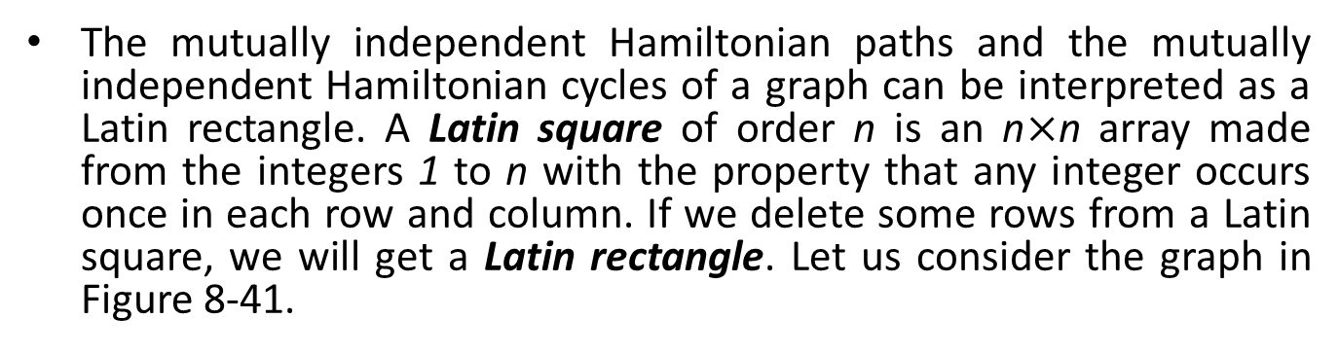
The mutually independent Hamiltonian paths and the mutually independent Hamiltonian cycles of a graph can be interpreted as a Latin rectangle. A Latin square of order n is an n$×$n array made from the integers 1 to n with the property that any integer occurs once in each row and column. If we delete some rows from a Latin square, we will get a Latin rectangle. Let us consider the graph in Figure 8-41.
Figure 8-41
Let C₁:0,1,2,3,4,0, C₂:0,2,3,4,1,0, C₃:0,3,4,1,2,0, and C₄:0,4,1,2,3,0. As you can see, C₁, C₂, C₃, and C₄ are mutually independent. This means there are four mutually independent Hamiltonian cycles of the graph in Figure 8-41 at any vertex.

Slide 66
We rewrite C₁, C₂, C₃, and C₄ into the following Latin square:
Figure 8-41
Recently, people have become interested in a mathematical puzzle called Sudoku. Sudoku can be viewed as a 9×9 Latin square with some constraints. There are several variations of Sudoku that have been introduced. Mutually independent Hamiltonian paths and cycles are basically variations of Sudoku.

Slide 67
Mutually independent Hamiltonicity of graphs can be applied to many areas of life. Consider the following scenario. Near Christmastime, we have a 10-day holiday. A tour agency wants to organize a 10-day tour to Italy. Suppose that many are interested in joining this tour. However, the maximum number of people staying in each local area is limited, say 100 people, due to hotel space constraints. One superficial solution to this problem is operating by the principle of First-Come-First-Served. This results in only 100 people being able to go on the tour (note that we cannot ask people to come back another time because the holiday period is fixed). Observe that a tour is like a Hamiltonian cycle based on a graph, in which a vertex is denoted as a hotel and any two vertices are joined with an edge if the associated two hotels are within a reasonable distance. Therefore, we can organize several subgroups, each with its own non-overlapping tour times. In other words, any two different tours are indeed independent Hamiltonian cycles. Suppose that there are 10 mutually independent Hamiltonian cycles. Then we may allow 1000 people to visit Italy during Christmas vacation. Practical considerations like this motivate our search for the maximum number of mutually independent Hamiltonian cycles. Such applications are useful for scheduling tasks and resource allocation, which are also important for compiler optimization to exploit parallelism.

Slide 68
Suggested Reading and Possible Future Directions
It seems that Latin squares were originally mathematical curiosities, but serious statistical applications as "experimental designs" were found early in the 20th century. The classic example is the use of a Latin square configuration to place 3 or 4 different grain varieties in test patches. Having multiple patches for each variety helps to minimize localized soil effects. Similar statements can be made about medical "treatments."
The concept of mutually independent Hamiltonian paths was introduced by Lin, Huang, Hsu, and S. Bau [2]. Then the concept of mutually independent Hamiltonian cycles was introduced by Sun, Lin, Huang, and Hsu [4]. Ho [1] discussed the relationship between cubic 2-independent Hamiltonian connected graphs, 1-fault tolerant Hamiltonian graphs, and globally 3*-connected graphs. Some applications of mutually independent Hamiltonian paths and mutually independent Hamiltonian cycles are presented elsewhere [3]. This is the final chapter of this book so any further future directions will have to be found by the reader.

Slide 69
References:
T.Y. Ho, C.N. Hung, and L.H. Hsu (2007), On cubic 2-independent Hamiltonian connected graphs, Journal of Combinatorial Optimization, Vol. 14, pp. 275-294.
C. K. Lin, H. M. Huang, L.H. Hsu, and S. Bau (2005), Mutually Independent Hamiltonian Paths in Star Networks, Networks, pp. 100-117.
C.K. Lin, J.J.M. Tan, H.M. Huang, D. F. Hsu, and L.H. Hsu (2009), Mutually independent hamiltonian cycles for the pancake graphs and the star graphs, Discrete Mathematics, Vol. 309 pp. 5474-5483.
C.M. Sun, C.K. Lin, H.M. Huang, and L.H. Hsu (2006), "Mutually Independent Hamiltonian Paths and Cycles in Hypercubes," Journal of Interconnection Networks, Vol. 7, pp. 235-255.

